Slide 1
You-tube Content Monetization Modeler
2024
Likes, views, subscribers,…
2025
Engagement ratio,…
Future Prediction
ML Powered Analytics
Presenter Geetha Palanisamy
MDTM46B

Slide 2

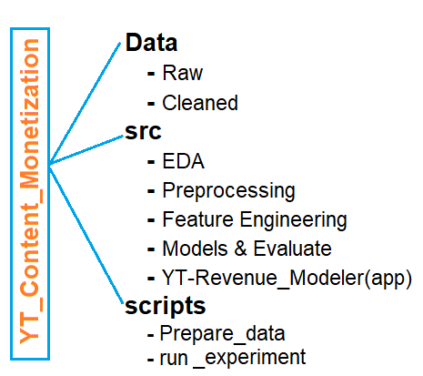
PROJECT OVERVIEW
PROJECT GOAL
Build a smart tool that helps YouTubers and advertisers make better decisions by predicting how much money a video might earn—before it's even published.
TOOLS USED
Python
Data handling , preprocessing, Feature Engineering
Model Building & Evaluation
Backend Logic for prediction
Streamlit
Visual EDA
What If Analysis
Random sample test

Slide 3
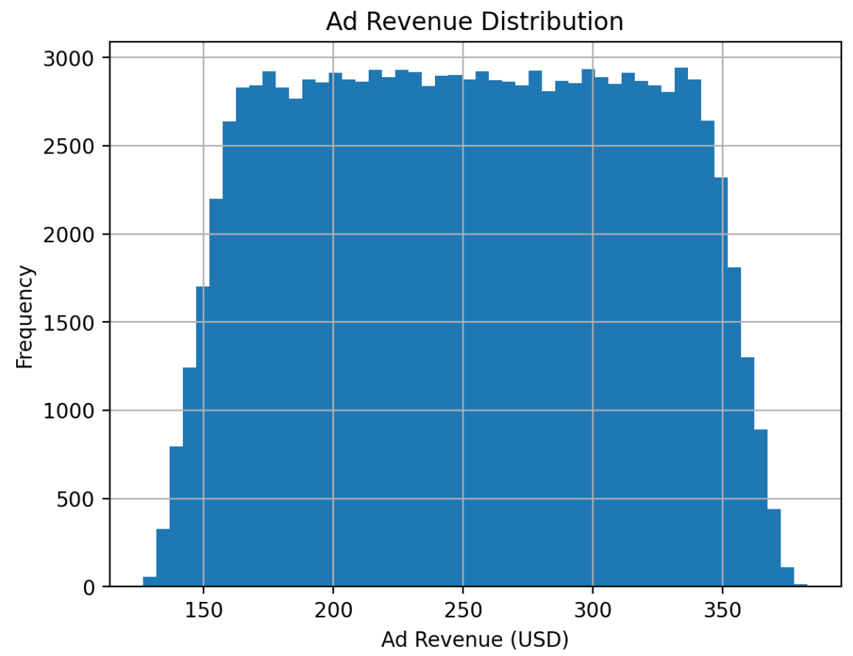
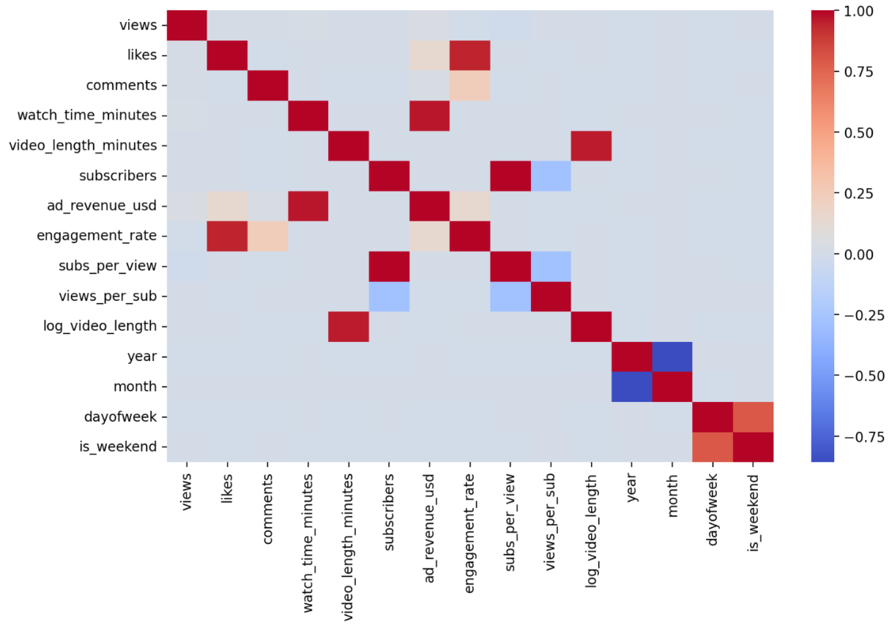
DATA HANDLING
FEATURE ENGINEERING
Raw data shape : (122400,12)
Dropped duplicate rows : 2400
Missing values before cleaning: 29696
Missing values before cleaning: 0
Cleaned data shape : (119139,22)
Train size: (95311, 21), Test size: (23828, 21)
Numeric cols: 11, Categorical cols: 6
1. Engagement Rate
(likes + comments) / views
2. Subscribers Influence → subs per view, views per subscriber.
3. Video Length Features →
log(video_length_minutes) (to reduce skew).
length_category → short (<5 mins), medium, long, very long
4.Date Features → from the video’s upload date:
Year, month, weekday, weekend flag.
EDA
Target distribution (ad revenue): graph shows entities are concentrated in a middle to high band (175-350 USD) and rarity of extremes
Correlation heatmap : views, likes, and subscribers,weekend had strong positive correlation with revenue.

Slide 4
PREPROCESSING
MODEL TRAINING AND EVALUATION
Numerical data
Fill missing values with median and standardize
Models | R2 | RMSE | MAE
Linear Regression | 0.952762362 | 13.53769017 | 3.034528013
Ridge | 0.952762307 | 13.53769804 | 3.034390776
Lasso | 0.951746762 | 13.68244505 | 4.281719614
Decision Tree | 0.949358414 | 14.01696968 | 4.469784573
Random Forest | 0.951711642 | 13.68742346 | 3.429372884
Gradient Boosting | 0.951674995 | 13.69261633 | 4.265382738
Categorical data
*For linear data : One Hot Encoding
*For tree models : Frequency Encoding
BEST MODEL
Linear Regression
Why?
Highest R^2: explains most (~95.3%) of variance in prices (target variable)
Lowest RMSE and MAE : indicates smallest average prediction error, i.e Most predictions are closer to actual prices
Simplicity : Linear models are easy to interpret and train

Slide 5
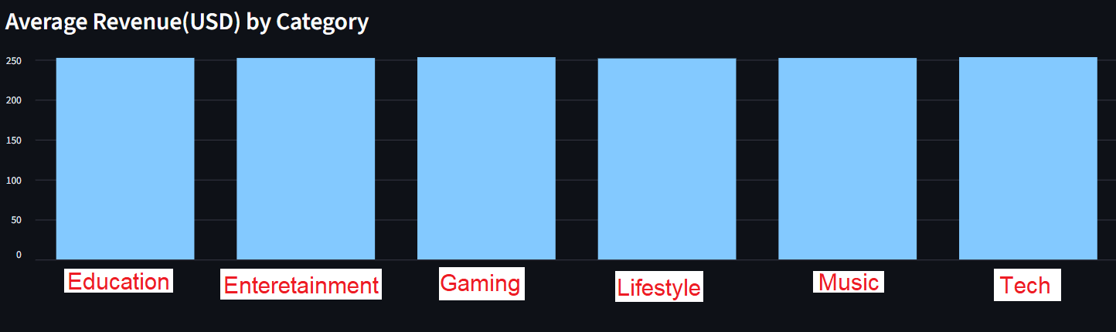
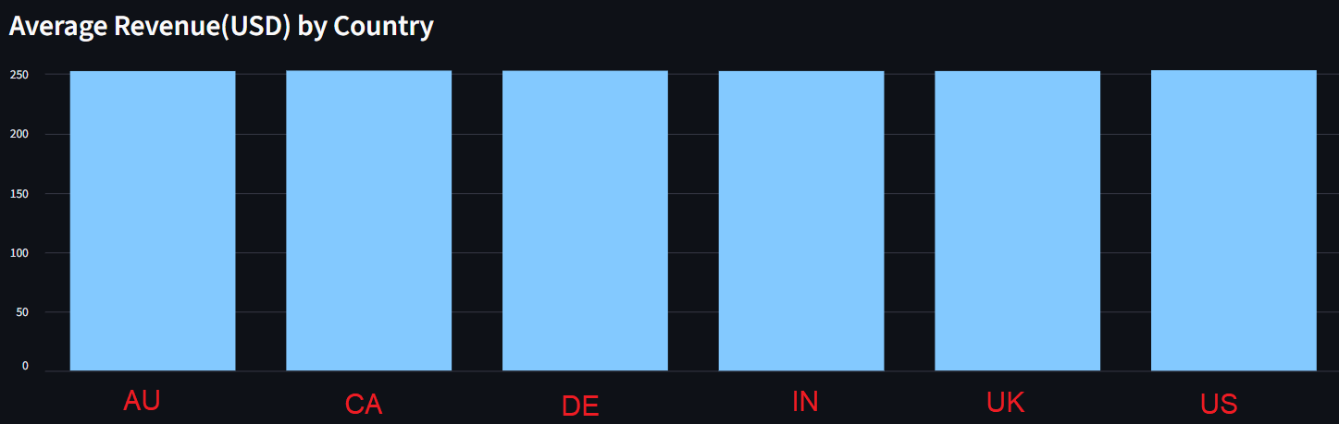
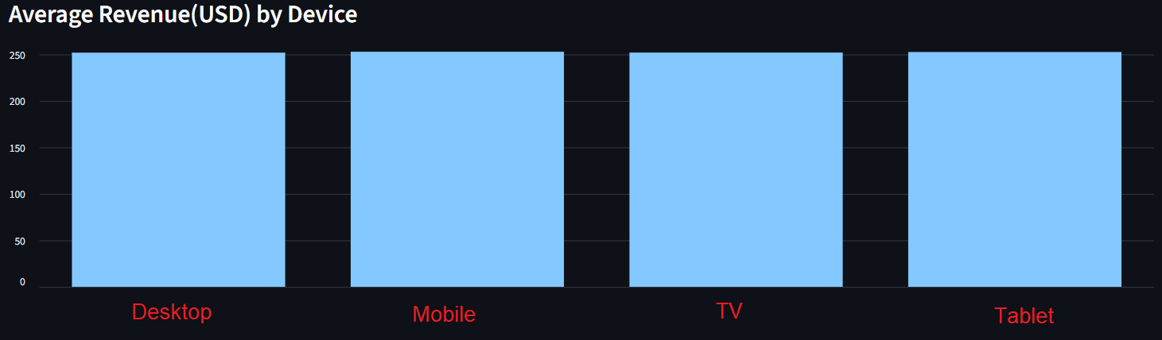
CONTENT STRATEGY OPTIMIZATION
252.56
252.42
253.44
251.90
252.43
253.48
Revenue distribution: Ad revenue is spread fairly evenly across countries and devices (average ≈ $252–253).
This shows Continuous features (likes, comments, watch time, subscribers) have much stronger impact on revenue than categorical ones.
Category-level differences are minimal, suggesting content type alone does not drive revenue significantly.
252.44
252.86
252.76
252.50
252.49
253.19
252.26
253.25
252.34
252.96

Slide 6
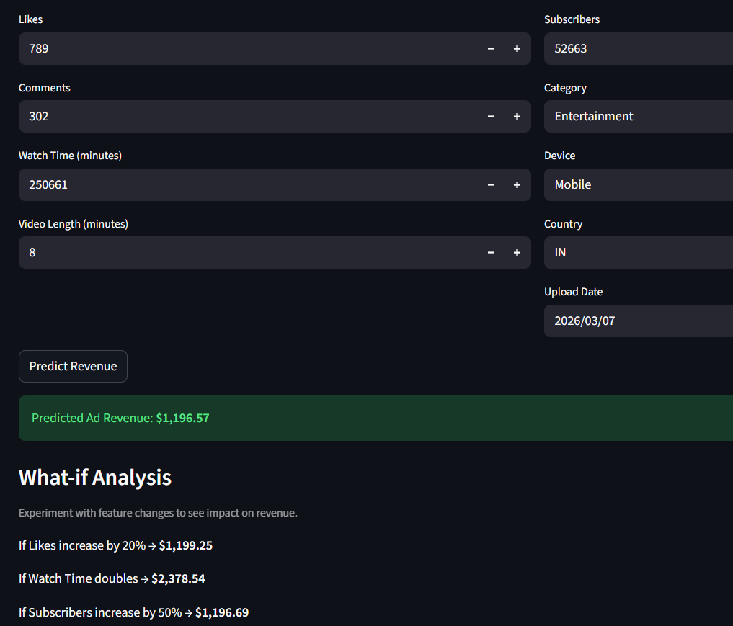
REVENUE FORECASTING
For this scenario: (varies with input)
Base Prediction: $1,196.57
+20% Likes: $1,199.25 → noticeable increase (~0.2%)
Double Watch Time: $2,378.54 → very strong jump (~140.5%)
+50% Subscribers: $1196.69 → almost no change (<0.01%)
Inference
Watch time is the most important driver for advertisement revenue
Likes and engagement is moderately important, but not directly influence much
Subscribers won’t directly translate into revenue
Also device type, content type, week end have moderate impact on revenue.

Slide 7

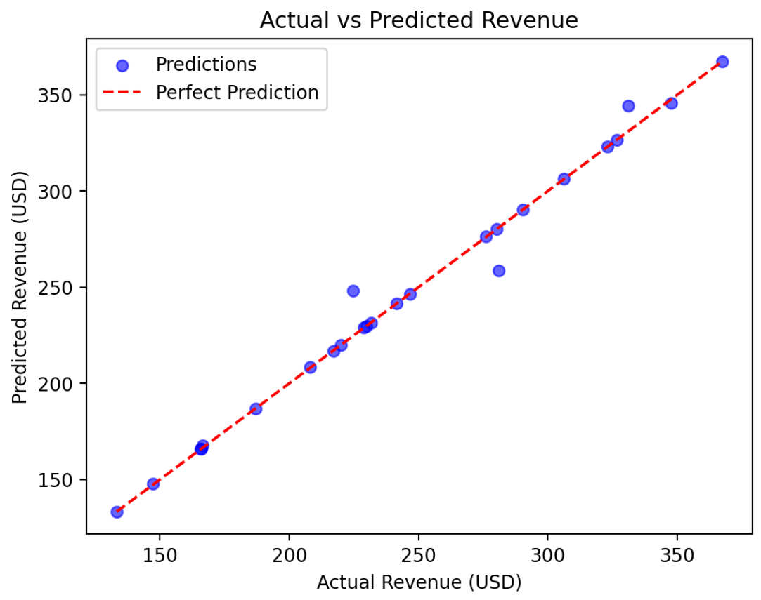
Random sample Test
Most blue dots (prediction) are clustered close to red line shows high prediction accuracy
Also shows that model has learnt meaningful patterns
Device type and video category also likely to contribute to variance
Ad promotion strategy
Advertisers should target videos with high audience retention and long watch durations
Optimize Ad placement
Analyze which category videos get longer watch time
Promote series/playlists instead of one-off videos

